Slide 1

Flipkart - Customer Sentiment Analysis
Digital Media Analysis
MGMT 4084
Professor: Amit Kukreja
GROUP MEMBERS
Oreoluwa Anibijuwon
Vivek Arora
Andres Siller Castro
Quan Anh Nghiem
Aisosa Osifo Kenneth
Yang Xu

Slide 2


Flipkart and Sentiment analysis
Flipkart is one of Indias' largest e-commerce platforms, which offers a diverse product range including electronics, clothing, and home décor. Having millions of customer interactions, understanding consumer sentiments is vital for shaping effective business strategies.
Project Overview
Analyze customer sentiment from Flipkart reviews
Uncover trends in consumer opinion across product categories

Slide 3


Research Objectives
Assess overall sentiment distribution across product categories on Flipkart.com.
Identify key themes within positive, neutral, and negative sentiments using topic labeling.
Evaluate the correlation between product price, rating, and sentiment.
Compare sentiment trends across major product categories to determine customer satisfaction drivers.
Research Questions
What is the general sentiment distribution across different product categories?
Which topics or themes emerge within each sentiment category?
How do price and ratings influence customer sentiment?
Which product categories reflect the highest and lowest customer satisfaction?

Slide 4






Methodology
Product Categories
Electronics
Clothing (Men’s, Women’s, Kids)
Home decor
Automated systems
December 2022
Sentiment Attributes
Positive feedback
Negative feedback
Product quality
Customer satisfaction
Data Cleaning 205,053 reviews 104 types across categories
Task | Description | Tool
Encoding Fix | Resolve '????' issues using UTF-8 encoding | Pandas
Duplicate Removal | Identify and remove duplicates | .drop_duplicates()
Handle Missing Values | Replace missing numeric values with median | .fillna()
Text Preprocessing | Remove punctuation, stopwords | NLTK
Sentiment Standardization | Normalize labels: Positive, Neutral, Negative | Pandas
Rating Normalization | 1-5 Scale | Pandas

Slide 5
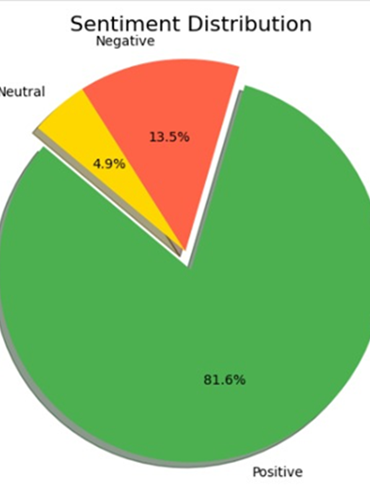
Insights about the Research Problem
Sentiment distribution and Key Theme
Imbalance in Sentiment Distribution: 82% Positive, 13%Negative, <5% neutral.
Predominance of Positive Sentiment
Majority of customers satisfied with their purchases.
Consistent with broader e-commerce trends.
Focus on product quality, delivery speed, and value for money .
Negative Sentiment & Area for improvement
13% of reviews negative, pointing to issues like product defects and delivery delays.
Actionable insights to improve quality and logistics.
Neutral Sentiment
Less than 5% of reviews, indicating a gap in balanced or indifferent feedack.
Opportunity to explore mixed experiences and uncover overlooked aspects.

Slide 6
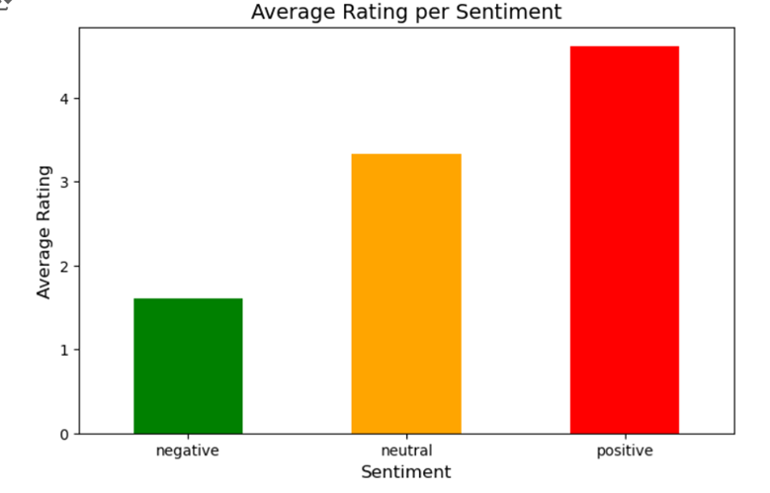
Insights about the Research Problem
Rating, Price Correlation & Cross-Sentiment Observations
Ratings & Sentiment Correlation
Negative Sentiment: 1-2 Star ratings, often linked to product quality or service
Positive Sentiment: 4-5 star ratings, reflecting satisfaction with product and pricing
Theme in Sentiment:
Positive reviews: Praise for quality, functionality, durability
Negative reviews: Concerns over delivery delays and product defects
Price sensitivity as a key driver of satisfaction
Cross-Sentiment Observations:
Word like "good" and "money" appear in both positive and negative feedback
Contex matters: "Good" in positive reviews versus neutral feedback
Price Concerns frequently arise in negative sentiment, highlighting value for money issues

Slide 7
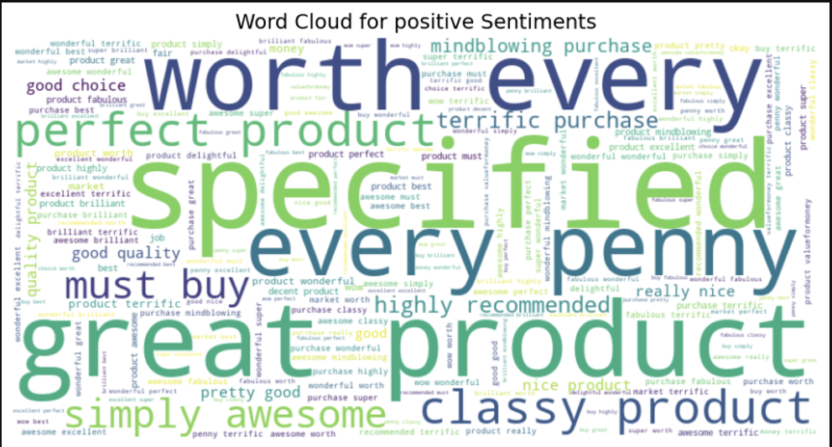
Key Insights from Positive Sentiments
Overview:
Dominated by phrases like "worth every penny", "great product", and "highly recommended".
Reflects strong customer satisfaction with Flipkart products.
Key Themes:
Product quality, reliability, and value for money.
Positive adjectives: "awesome", "classy", "mindblowing".
Implications:
Highlights that customers perceive high-quality products as exceeding expectations.
Reinforce strengths in marketing campaigns to attract and retain customers.

Slide 8
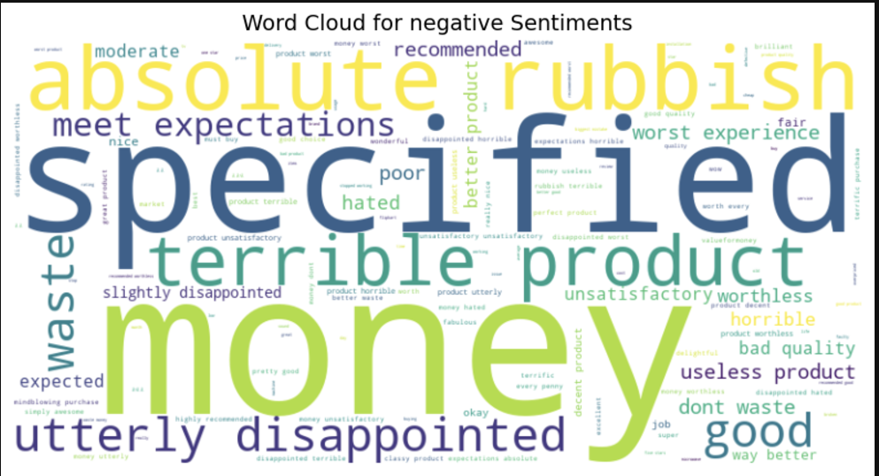
Key Insights from Negative Sentiments
Overview:
Common phrases: "absolute rubbish", "utterly disappointed", "waste money".
Indicates dissatisfaction with product defects and unmet expectations.
Key Themes:
Financial dissatisfaction (e.g., "money").
Harsh feedback about product quality (e.g., "horrible", "worthless").
Implications:
Actionable insights for quality control and delivery improvements.
Address specific pain points to reduce negative reviews and improve satisfaction.

Slide 9
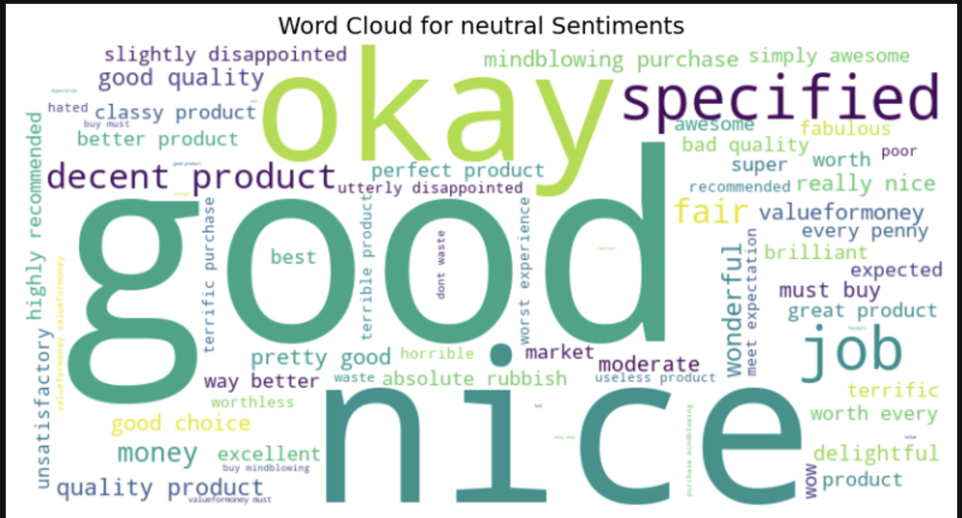
Key Insights from Nuetral Sentiments
Overview:
Words like "okay", "nice", and "decent product" dominate.
Reflects moderate satisfaction or mixed experiences.
Key Themes:
Balance between positive and negative aspects.
Customers may feel their expectations were partially met.
Implications:
Opportunity to investigate what keeps these experiences from being fully positive.
Develop strategies to elevate customer satisfaction and convert neutral experiences into positive ones.

Slide 10

Sentiment Distribution and Predominance of Positive Sentiment
Imbalance in Sentiment Distribution:
Significant disparity between positive (82%), negative (13%), and neutral (<5%) sentiments.
Indicates underrepresentation of dissatisfied or neutral customers.
Suggests the need for feedback across the spectrum for a holistic understanding.
Predominance of Positive Sentiment:
Reflects strong customer satisfaction, aligning with broader e-commerce trends.
Key drivers: product quality, delivery speed, and value for money.
Reinforces Flipkart’s success in meeting customer expectations and building loyalty.

Slide 11

Negative and Neutral Sentiments
Negative Sentiment (13%):
Highlights critical issues: product defects, delivery delays, and unmet expectations.
Points to areas for improvement in quality control and logistics.
Reducing negative feedback can enhance retention and reputation.
Neutral Sentiment (<5%):
Indicates moderate or indifferent experiences.
Opportunity to explore overlooked aspects of customer experience.
May signal ambiguity in product quality or delivery performance.

Slide 12
Ratings, Themes, and Cross-Sentiment Observations
Ratings and Price Correlation:
Negative sentiment tied to 1-2 star ratings (value-for-money concerns).
Positive sentiment linked to 4-5 star ratings (satisfaction with quality and pricing).
Key Themes:
Drivers of satisfaction: product quality, delivery speed, customer service.
Dissatisfaction stems from delays and defects.

Slide 13

Conclusion
Main Evidence from Sentiment Analysis
1. Sentiment Distribution
Positive (82%): High customer satisfaction, aligning with e-commerce trends.
Negative (13%): Focused on product defects and delivery delays.
Neutral (<5%): Minimal, indicating polarized opinions (positive/negative).
2. Correlation Between Price, Rating, and Sentiment
Positive Sentiment: Linked to high ratings (4-5 stars), reflecting satisfaction with quality, delivery, and value.
Negative Sentiment: Associated with low ratings (1-2 stars), highlighting dissatisfaction with defects and delays.

Slide 14
Conclusion
Key Themes in Feedback
Positive: Quality products, efficient delivery, and good customer service.
Negative: Product defects and delays.
4. Imbalance in Sentiment Distribution
Skewed toward positive reviews, potentially underrepresenting dissatisfied or neutral customers.
Highlights the need for systems capturing a broader range of experiences.

Slide 15

Recommendations
1. Leverage Customer Feedback
Recommendation:
Address customer pain points: payments, products, refunds
Measures:
Improve AI-driven chatbots for instant support
Enhance staff training for complaint handling
Track KPIs: response time, complaint resolution rate
2. Leave more descriptive reviews
Recommendation:
Encourage detailed feedbacks on key attributes
Measures:
Prompt users with the guided questions
Introduce review incentives: discounts, $1k
Extract key review insights - Improvement
3. Relationship between price, sentiment, ratings
Recommendation:
Identify price points: customer sentiment & profitability
Measures:
Recalibrate product pricing by sentiment analysis
Identify patterns in price points
Implement dynamic pricing models for flexibility

Slide 16

Recommendations
4. Address Product Delivery Delays
Recommendation:
Reduce delivery time & improve transparency
Measures:
Partner with local delivery services
Provide real-time order tracking & automated status updates
Collect post-delivery feedback
5. Improve Sentiment Classification for Neutral Reviews
Recommendation:
Increase model accuracy for neutral sentiment
Measures:
Use active learning for continuous improvement
Combine lexicon-based and ML-based approaches
Fine-tune ML models with domain-specific data
6. Build customer trust & loyalty
Recommendation:
Provide clear & accessible information
Measures:
Improve product transparency
Launch customer education campaigns

Slide 17

Research Suggestions
1. Enhance the diversity of customer feedback
Incorporate reviews from multiple e-commerce platforms
2. Complement the sentiment analysis
Conduct qualitative analysis & Thematic analysis
3. Address sentiment imbalance by targeted surveys
Gather feedback from neutral & dissatisfied customers
4. Leverage AI & ML
Improve customer service, website usability, refund policies, etc.
Track sentiment trends better

